Slide 1
Data Science Capstone project
Sunil Kumar
04/06/2022

Slide 2

Outline
Executive Summary
Introduction
Methodology
Results
Conclusion
Appendix

Slide 3

Executive Summary
Summary of methodologies
Summary of all results

Slide 4

Introduction
Project background and context
Problems you want to find answers

Slide 5

Methodology
Data collection methodology:
Data collection using API
Data collection using web scraper
Perform data wrangling
Data wrangling using Auxiliary Functions
Perform exploratory data analysis (EDA) using visualization and SQL
Perform interactive visual analytics using Folium and Plotly Dash
Perform predictive analysis using classification models
Predictive analysis using Machine Learning

Slide 6
Methodology

Slide 7
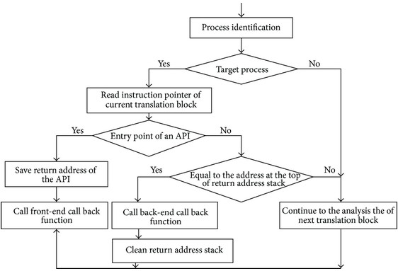
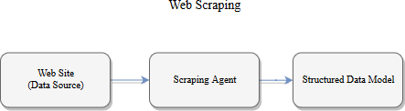
Data collection
Data collection is a systematic process of gathering observations or measurements. Whether you are performing research for business, governmental or academic purposes, data collection allows you to gain first-hand knowledge and original insights into your research problem.

Slide 8
Data collection – SpaceX API

Slide 9
Data collection – Web scraping

Slide 10
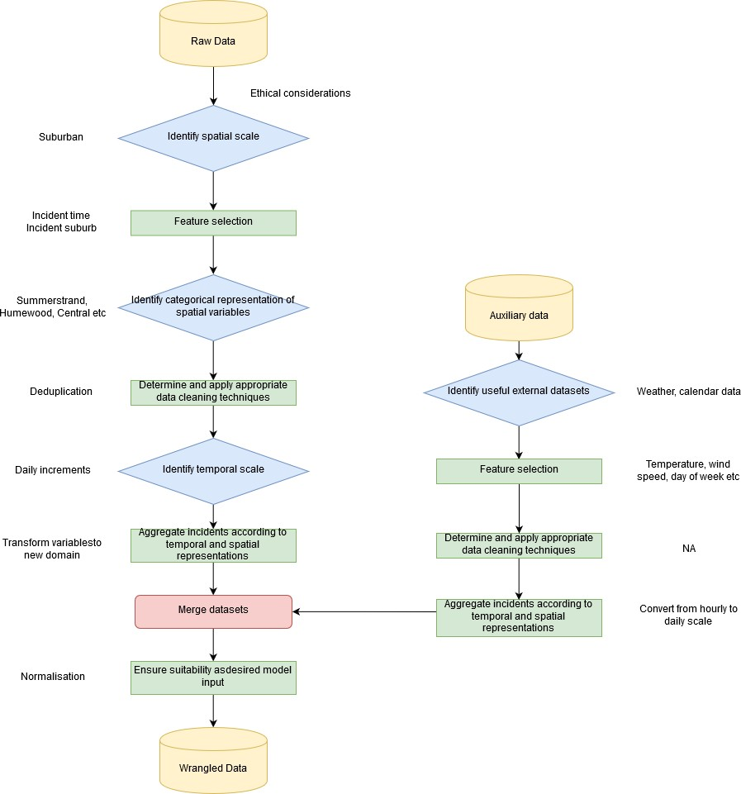
Data wrangling
Data wrangling is the process of cleaning and unifying messy and complex data sets for easy access and analysis. With the amount of data and data sources rapidly growing and expanding, it is getting increasingly essential for large amounts of available data to be organized for analysis. This process typically includes manually converting and mapping data from one raw form into another format to allow for more convenient consumption and organization of the data.

Slide 11
EDA with data visualization
To find out the relationship between features

Slide 12
EDA with SQL
Import the data into database
Querying the data you want to find out

Slide 13
Build an interactive map with Folium
Map objects such as markers, circles, lines, etc. as a marker for the launch site
To find out the details of the location of the launch site

Slide 14
Build a Dashboard with Plotly Dash
Dropdown filter and chart
To find out each launch site

Slide 15
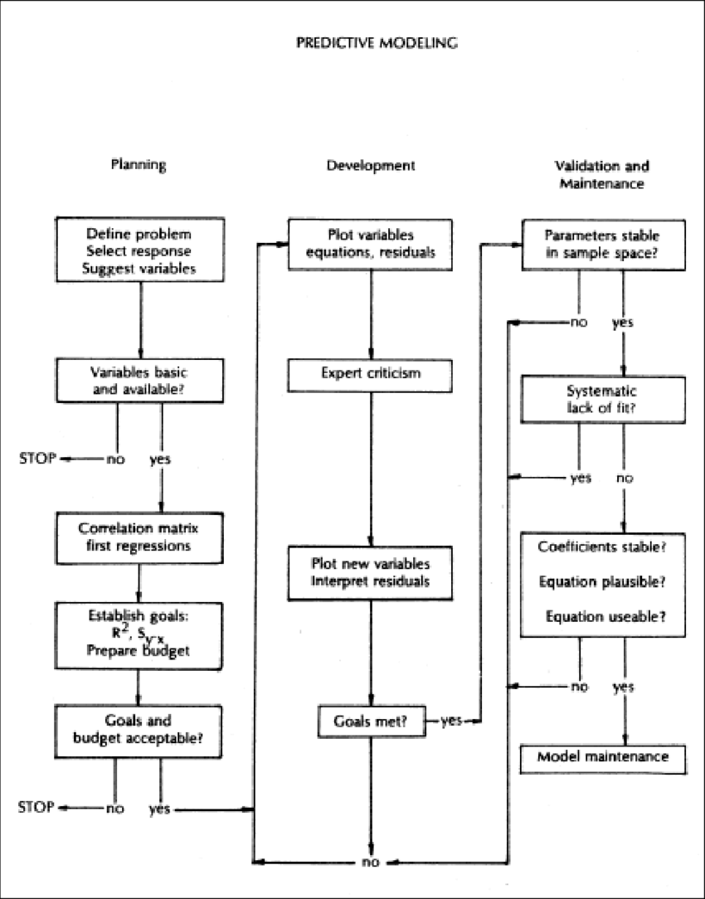
Predictive analysis (Classification)
Using Machine Learning for predictive analysis with KNN, SVM, Decision Tree, and Logistic Regression, evaluated with Jaccard Score and F1 Score
https://github.com/sunilkdudhe/Machine-Learning---Project-Notebook

Slide 16
Results
Exploratory data analysis results
Interactive analytics demo in screenshots
Predictive analysis results

Slide 17
EDA with Visualization

Slide 18
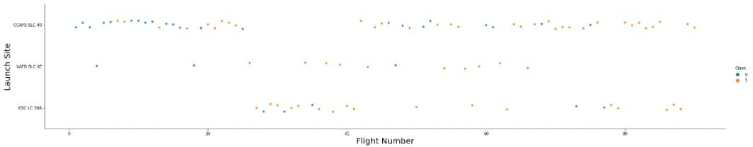
Flight Number vs. Launch Site
The highest success rate is in CCAPS SLC-40 launch site

Slide 19
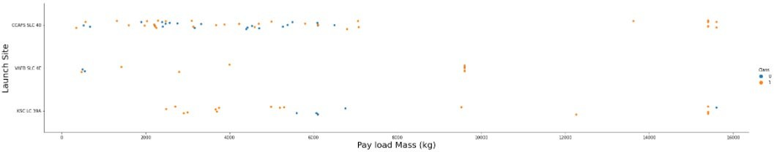
Payload vs. Launch Site
The highest pay load mass is in CCAPS SLC-40 launch site

Slide 20
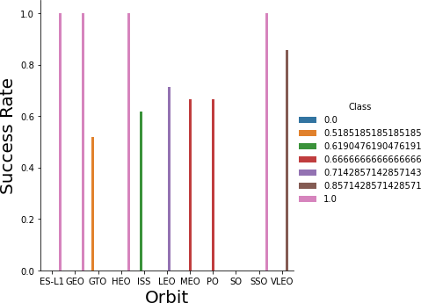
Success rate vs. Orbit type
ES-L1, GEO, HEO, and SSO orbit has highest success rate

Slide 21
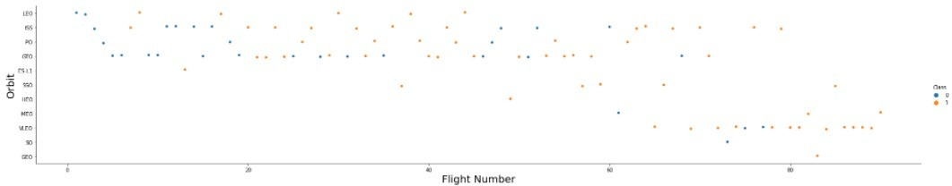
Flight Number vs. Orbit type
LEO, ISS, PO, and GEO orbit has highest flight number

Slide 22
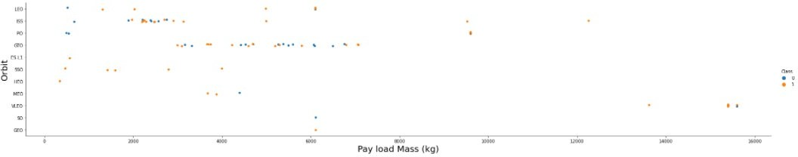
Payload vs. Orbit type
GEO orbit has highest pay load mass

Slide 23
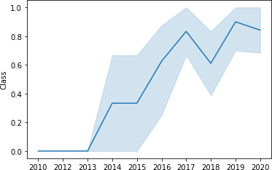
Launch success yearly trend
Every year the launch success rate increases

Slide 24
EDA with SQL

Slide 25
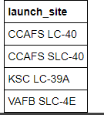
All launch site names
Theres four launch site

Slide 26

Launch site names begin with `CCA`
Theres two launch site names begin with ‘CCA’

Slide 27

Total payload mass
Total pay load mass 56479 kg

Slide 28

Average payload mass by F9 v1.1
Average payload mass by F9 v1.1 is 3676

Slide 29

First successful ground landing date
First successful ground landing on 2017-01-05

Slide 30

Successful drone ship landing with payload
between 4000 and 6000
Successful drone ship landing with payload between 4000 and 6000 is F9 FT B1022 and F9 FT B1031.2

Slide 31

Total number of successful and failure mission
outcomes
Total number of successful is 46 and failure is 0

Slide 32
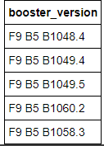
Boosters carried maximum payload
Boosters carried maximum payload is F9 B5 B1048.4, F9 B5 B1049.4, F9 B5 B1049.5, F9 B5 B1060.2, and F9 B5 B1058.3

Slide 33

2015 launch records
In 2015 the launch was carried out in october at the ccafs lc-40 launch site with booster version f9 v1.1 B1012 and landing outcome is failure (drone ship)

Slide 34
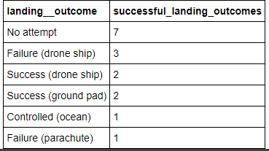
Rank success count between 2010-06-04 and
2017-03-20
landing outcome with no attempt status was ranked first with a total of 7 times and landing outcome with controlled (ocean) and failure (parachute) status was ranked last with a total of 1 time

Slide 35
Interactive map with Folium

Slide 36
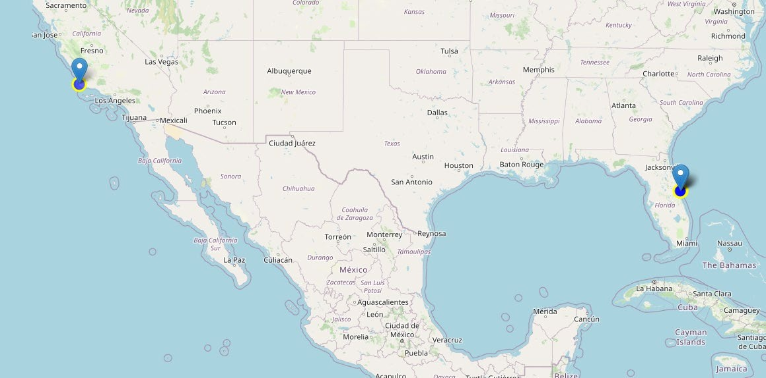
All Launch Sites
Theres 3 location launch site

Slide 37
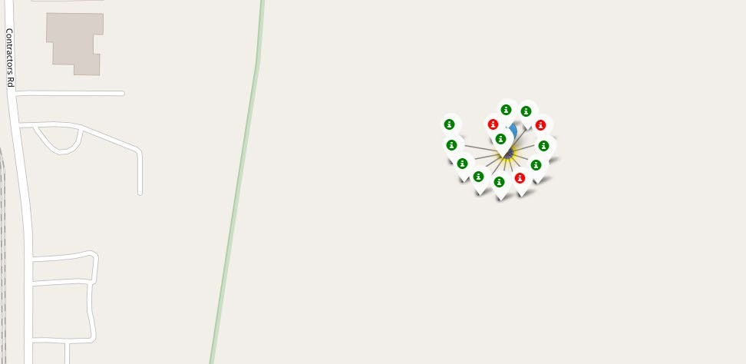
Color-labeled Launch Records
the green is success launch and the red is failure launch

Slide 38
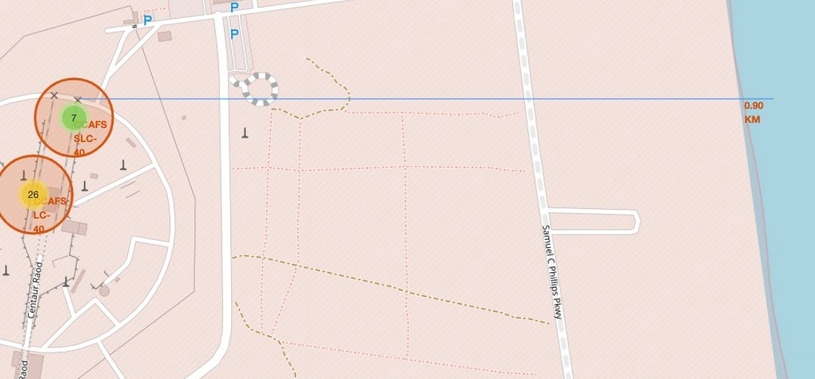
Launch Site to its Proximities Such as Railway, Highway, Coastline
to find out how far is the distance between the launch site and the railway, highway, coastline

Slide 39
Build a Dashboard with Plotly Dash

Slide 40
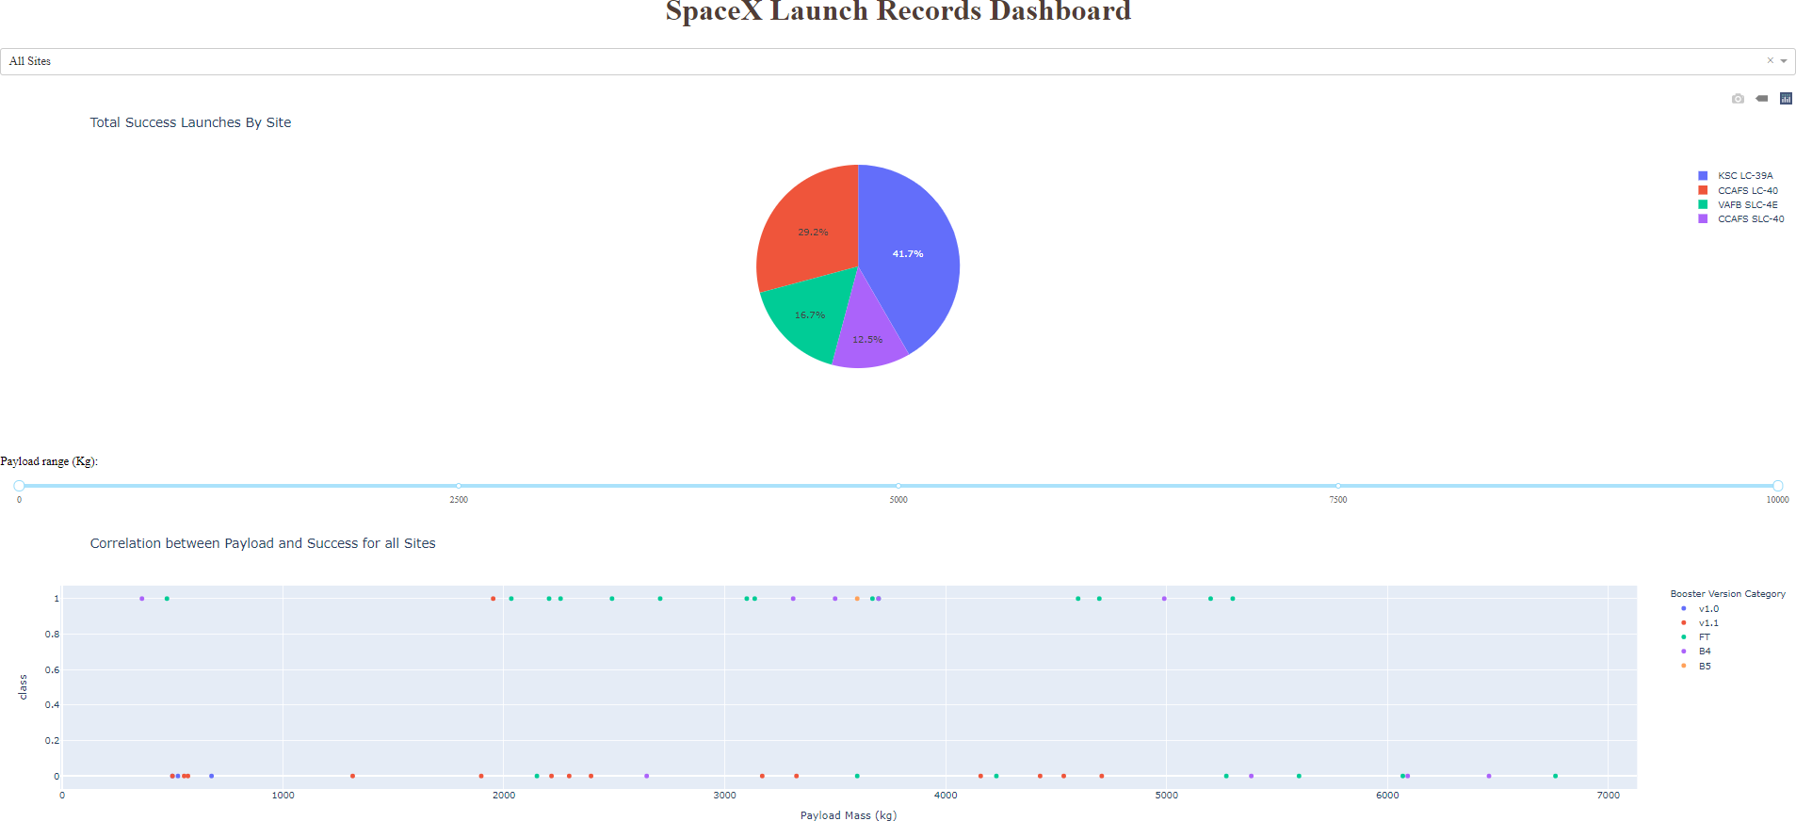
Launch Success Count for All Sites, in a Piechart

Slide 41
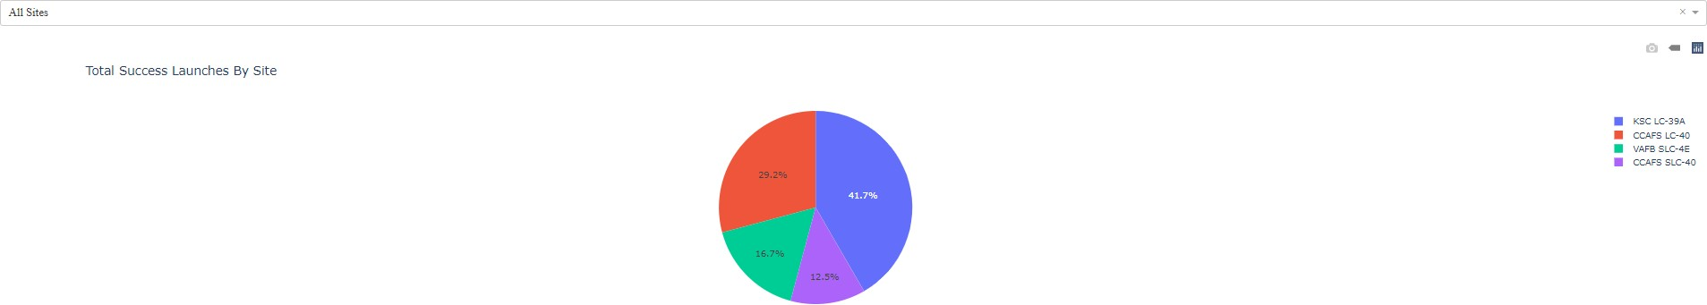
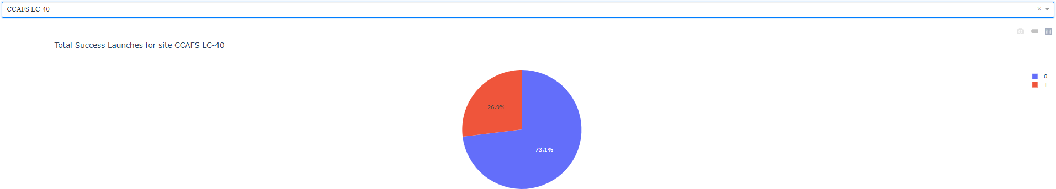
Piechart for The Launch Site With Highest Launch Success Ratio

Slide 42
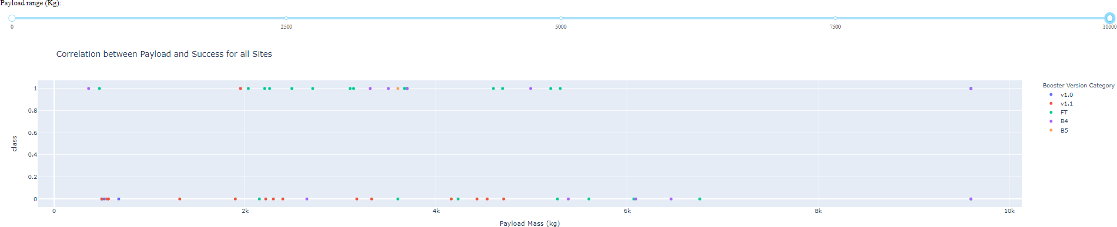
Payload vs. Launch Outcome Scatter Plot for All Sites

Slide 43
Predictive analysis (Classification)

Slide 44
Best Model Accuracy
Classification Accuracy
The highest classification accuracy is Decision Tree with accuracy = 88,75%
90
89
88
87
86
85
84
83
82
Logistic Regression
SVM
Decision Tree
KNN
Model Name

Slide 45
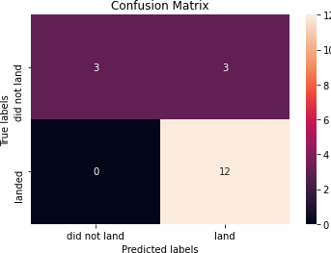
Confusion Matrix
The best perfoming nodel is Decision Tree with accuracy = 88.75%

Slide 46

CONCLUSION
The best classification model in this case is Decision Tree with 88,75% accuracy

Slide 47

APPENDIX
https://github.com/sunilkdudhe/Applied-Data-Science-Capstone

Slide 48
Thank You

